Slide 1
Communication and Record Keeping

Slide 2
LEARNING OUTCOMES
Aim
To understand the importance of both communication and record keeping during a response
Objectives
  List the communication methods used during a response
  Explain the need and importance of record keeping during a response
  List the do’s and don'ts when it comes to record keeping

Slide 3
Group exercise
  Communicating what you see to enable transfer of information
  Draw what hear
  Only listen no questions
  Emphasis on the accuracy of communications to aid the transfer of information.
Notes:
This summaries the intent of the ICS201.
Emphasise it represents the initial IAP (in effect) and much of the information is derived from the ERP’s

Slide 4
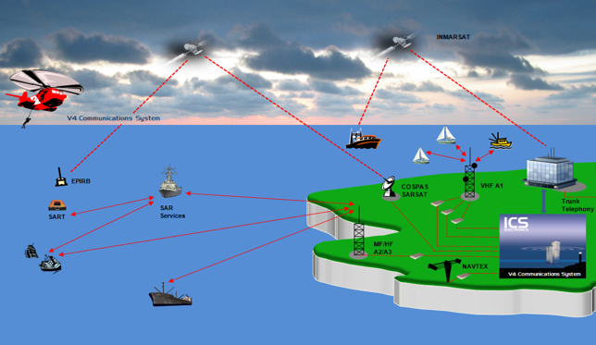
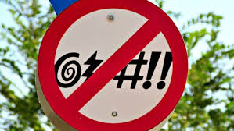
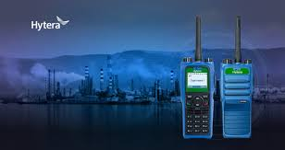
Communications Procedures
  Agree a channel
  Keep emergency channel clear
  Intrinsically safe
  Minimum ‘Talk’ time
  Speak slowly / clearly
  Clarification
  No swearing
Notes:
Agree a channel for all operation at the start of the day and test prior to start of work

Slide 5

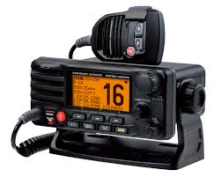
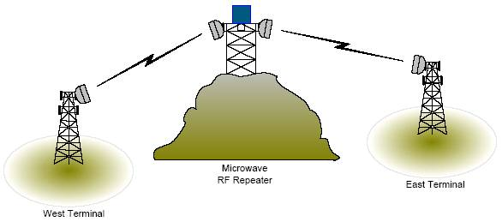
Communication Methods
  Satellite Communications
  Mobile Telephones
  VHF/UHF Radio
  Repeater Station
  Fax
  Email
  Public Telephone
Notes:
May have problems with certain communication methods depending on the terrain.

Slide 6
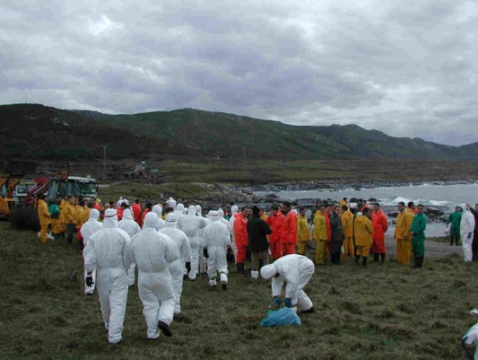
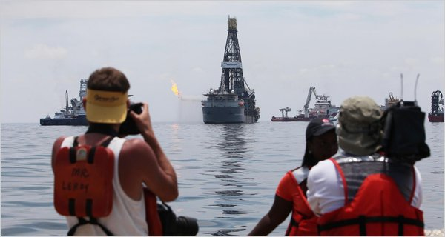
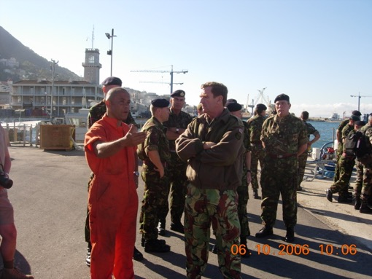
Field Briefings – Who needs to be briefed?
  All personnel working on site
  On coming shift
  Visitors
  Management
  Media
The levels of briefing will vary dependent on the audience and task
Notes:
Regardless of who they are and what they are doing, anyone who requires to go on to an operational site needs to be briefed on the situation so that they know the facts.
What information they require will vary depending on the reason that they are there.

Slide 7


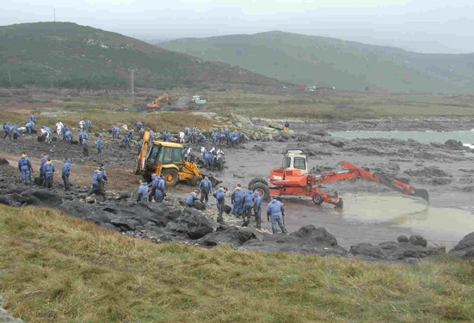
Why Do A Briefing?
  Safety Message
  Set Objectives
  Overview Of Other Operations
  Roll Call
  Answer Questions
Notes:
Safety
For some people it will be an alien environment and far removed from their normal day to day surroundings.
Makes them aware of the situation.
There may be safety issues from other sites that need to be made known regarding safety.
Objectives
Everyone knows the boundaries and the end goal.
Gives them a reason why they are there.
Overview
There may be a number of sites that are operational and it worth knowing how they are doing.
Roll Call
To ensure all personnel that you had the previous day have returned.
Questions
Things may have been discussed the previous the evening and questions arisen.

Slide 8
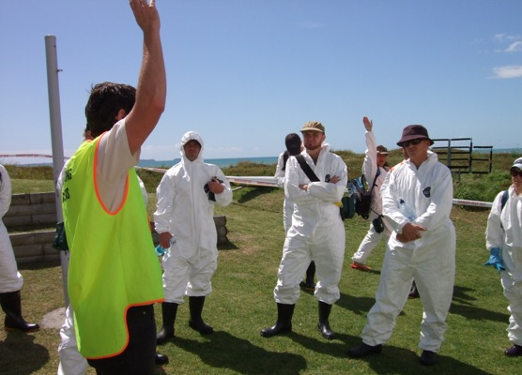
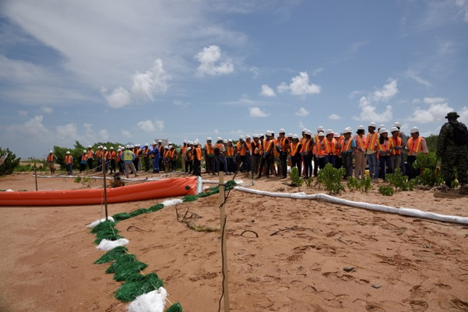
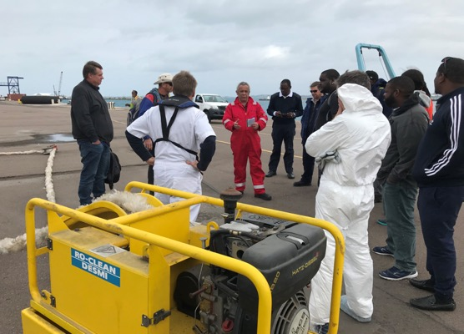
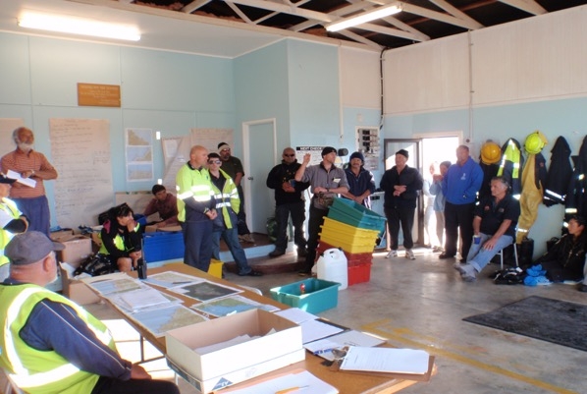
Where To Do The Briefing
  Under Cover
  Quiet
  No Distractions
  Offsite
Notes:
Protect from the elements rain or sun.
Quiet area so that people can hear you and do not possibly miss an important point.
Somewhere where the focus is on you and not things going on around them.
Prior to entering the work zone because there maybe some safety issues that need to be addressed in the brief.

Slide 9
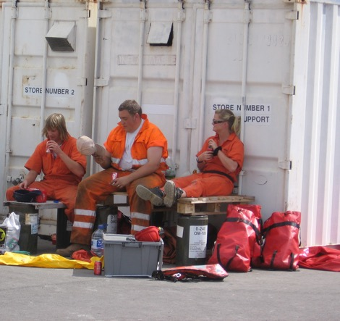
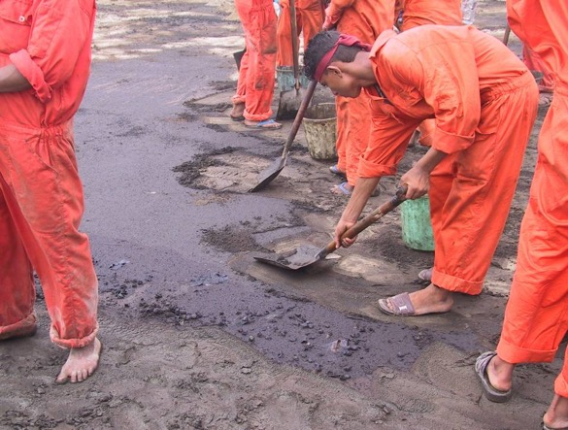
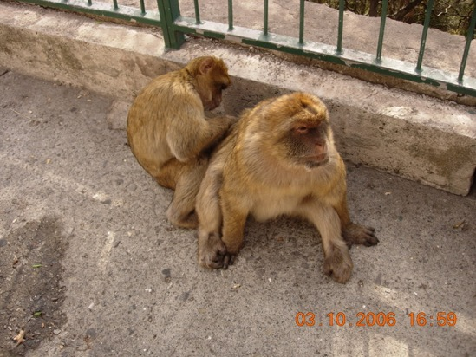
Contents of Briefing
  Safety Message
  Objectives
  Highlight Hazards
  Product information
  PPE level
  Cleanup Chemicals
  Welfare
  Breaks
  Weather
  Wildlife
Notes:
Protect from the elements rain or sun.
Quiet area so that people can hear you and do not possibly miss an important point.
Somewhere where the focus is on you and not things going on around them.
Prior to entering the work zone because there maybe some safety issues that need to be addressed in the brief.

Slide 10
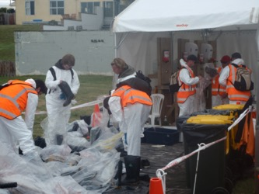
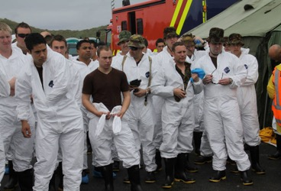
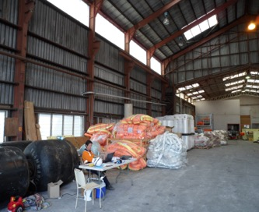
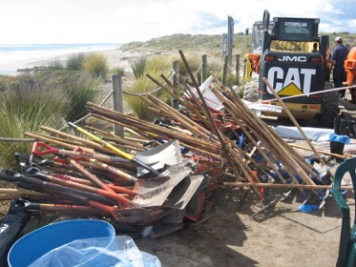
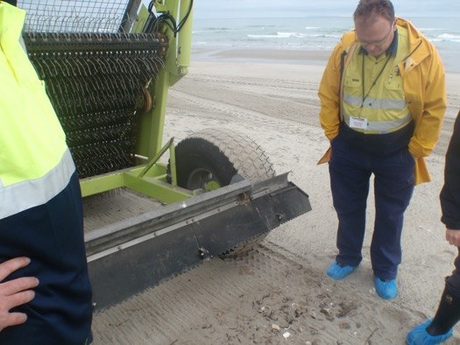
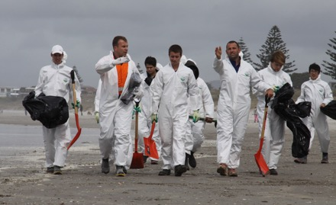
Beachmaster / Supervisors - Daily Tasks
  Muster team and present safety briefing and operational plan for the day
  Set day’s objectives
  Check PPE is correct for each worker
  Distribute clean-up equipment
  Commence daily log
  Check communications
  Reassess operational site
  During work monitor
  safety
  efficiency
  rest breaks
  Stock levels
Notes:
Brief the personnel on all aspects of the days operation and complete a safety briefing and train personnel on the operation of equipment if they are not familiar with it.
Set achievable objectives.
Ensure all personnel are wearing the correct PPE for the location.
Allocate equipment and tasks.

Slide 11
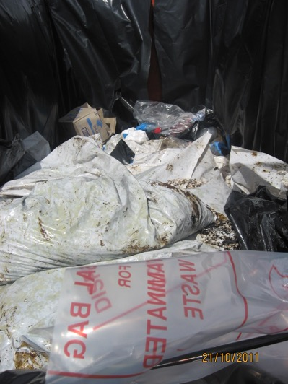
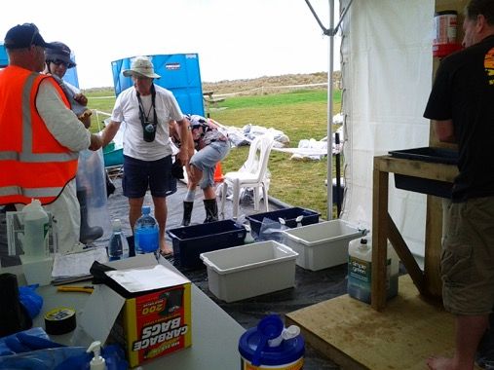
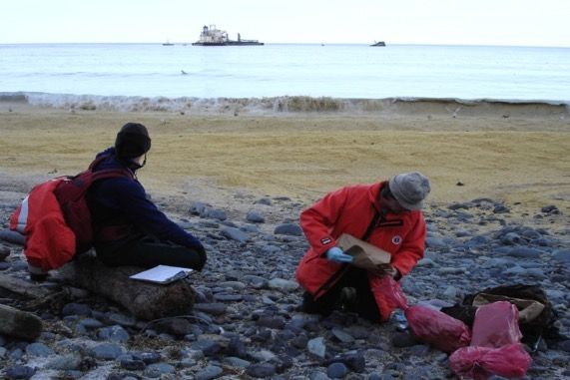
Beachmaster / Supervisors - Daily Tasks
  End of operational work period
  complete site progress report
  survey site for operationally generated rubbish
  ensure full decontamination of personnel and equipment
  complete log
Notes:
Ensure the progress report is completed by 15.00 and submitted.
All waste collected is above the high water mark in a controlled and marked area
Any equipment and personnel go through the correct procedures for decontamination
Complete and sign off log.

Slide 12

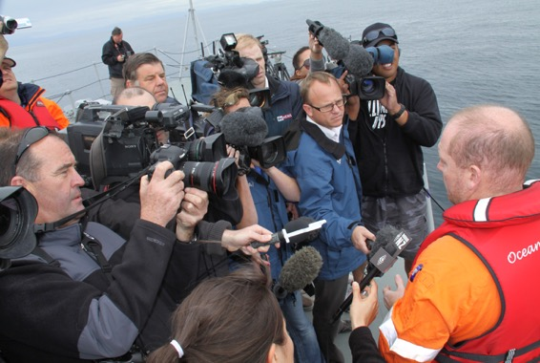
Media Handling
  Have Press Office contact number
  Escort media onsite
  Comment only on what is being carried out at this site….refer to Press Office for further information
  Do NOT speculate
  Set time constraint on media enquiries
Notes:
If possible pre-identify someone else to deal with the media. If the beach master is taken off site to speak to the media then work should stop because he is the safety officer overseeing the whole job and all operations.
Do not let the media have a free hand, escort them at all times to limit who they talk to and what they see.
Comment on the area you are working on and for more in depth information refer them to the press officer.
Never speculate on your site or any others and do not lie.Keep to the facts.
Set a time limit for their visit as it can be disruptive and slow the task down.

Slide 13


Why keep a log?
  Legal Reasons
  Accident Reporting / Health and Safety
  To record what you / your team were doing
  To cover yourself and the company
  To assist in statement preparation
  Insurance Claims
  To monitor the progress of the response
  To refresh your memory later on
  To give the full picture to the incident commander
  First version of events
  Events fresh in your mind
  Events accurate / not distorted
  Statements
  May be prepared months later
  Court Cases / Insurance Claims
  May be years later

Slide 14
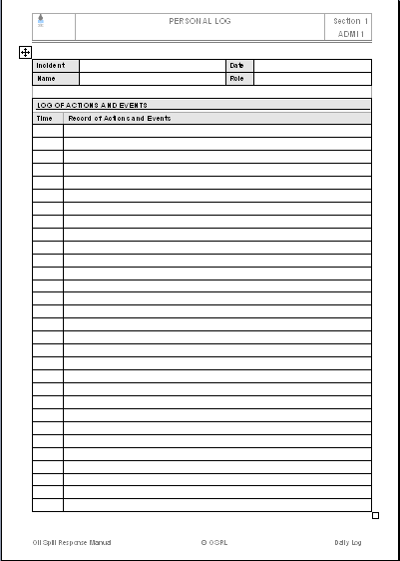
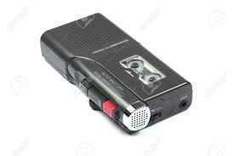
Different Types of Log
  Personal Log
  Written Log / Notebook
  Dictaphone
  Transcript
  Incident Log
  Voice Recorders
  Video
  Computer
  Written
  Notebook
  Ruled with margins
  New book for each incident
  Verbal
  Dictaphone
  New tape for each day
  Keep original tapes
  Have transcript typed up

Slide 15

Written Log - Do’s
  Write in BLACK ink (permanent)
  Ease of photocopying / Faxing
  Make entries Legible
  Enter time of each entry
  Accurately record all information
  Persons / Equipment on site
  Breaks taken
  You do not decide what is relevant
  Record Date / Hours of Work
  Write all names and locations in CAPITALS
  Ease for reference later
  Write all direct quotes in CAPITALS
  Get the person making the quote to sign your logbook
  Upon completion of working day, make a log entry, sign it and rule off that day

Slide 16

Written Log - Don’ts
  Erase entries
  Strike through mistakes with a single line and initial this
  Ensure original words are readable
  NO tippex
  Leave lines
  If a line is missed in error, strike through the line and write “Omitted in error” and sign next to this
  Leave blank pages
  If a page is missed in error, strike through the line and write “Omitted in error”. Sign next to this
  Overwrite words
  If a mistake is made, strike through the error with a single line, sign this and then write the correct word
  Write between lines
  If an entry is omitted, use the next available line and write time of the event and time of entry

Slide 17
Verbal Log - Do’s
  Use a new tape for each day
  At the start of each tape introduce yourself, the date, time and location where you are working
  Prefix each entry / recording with the time
  Accurately record all information
  Persons / Equipment on site
  Breaks taken
  You do not decide what is relevant
  Record conversations with external parties
  Inform them that you are recording the conversation for the purpose of log keeping
  Ensure a transcript is made of all tapes
  Keep each tape and give it a reference number

Slide 18
Verbal Log - Don’ts
  Record over errors
  State on the tape that the previous entry was an error
  Record over tapes
  Use a new tape for each day
  Discard tapes after incident
  May be required up to 6 years later

Slide 19
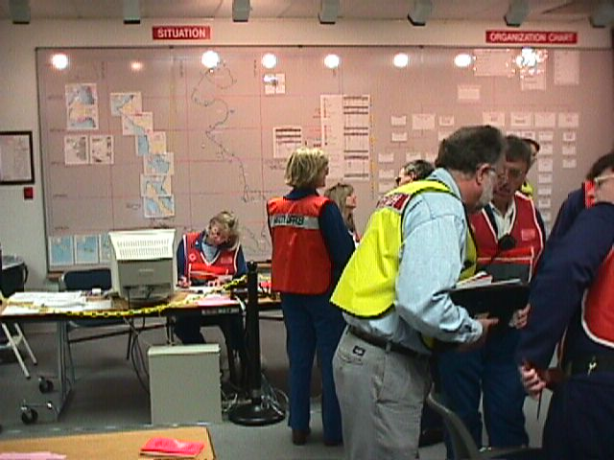
Incident Log
  Incident log kept in Command Centre. Used to record:
  Briefings given
  Telephone calls
  made / received
  Faxes sent / received
  Emails sent / received
  Decisions taken
  Usually kept by an Administrator
  Can be supplemented by:
  Video camera of Command Centre - ensure all tapes kept and labeled / referenced
  Voice recorders (General) - ensure all tapes kept and labeled / referenced
  Voice recorders (Telephone) - ensure all tapes kept and labeled / referenced and also that persons on phone are aware they are being taped

Slide 20
Everything must be kept!

Slide 21
You should now be able to……
  List the communication methods used during a response
  Explain the need and importance of record keeping during a response
  List the do’s and don'ts when it comes to record keeping

